Slide 1
Book Store
Mitchell Hess
Kevin Gautier
Bertha Assan Sackey
Abhinay Peeta
Durga Samrith Uppala

Slide 2

Introduction

Slide 3
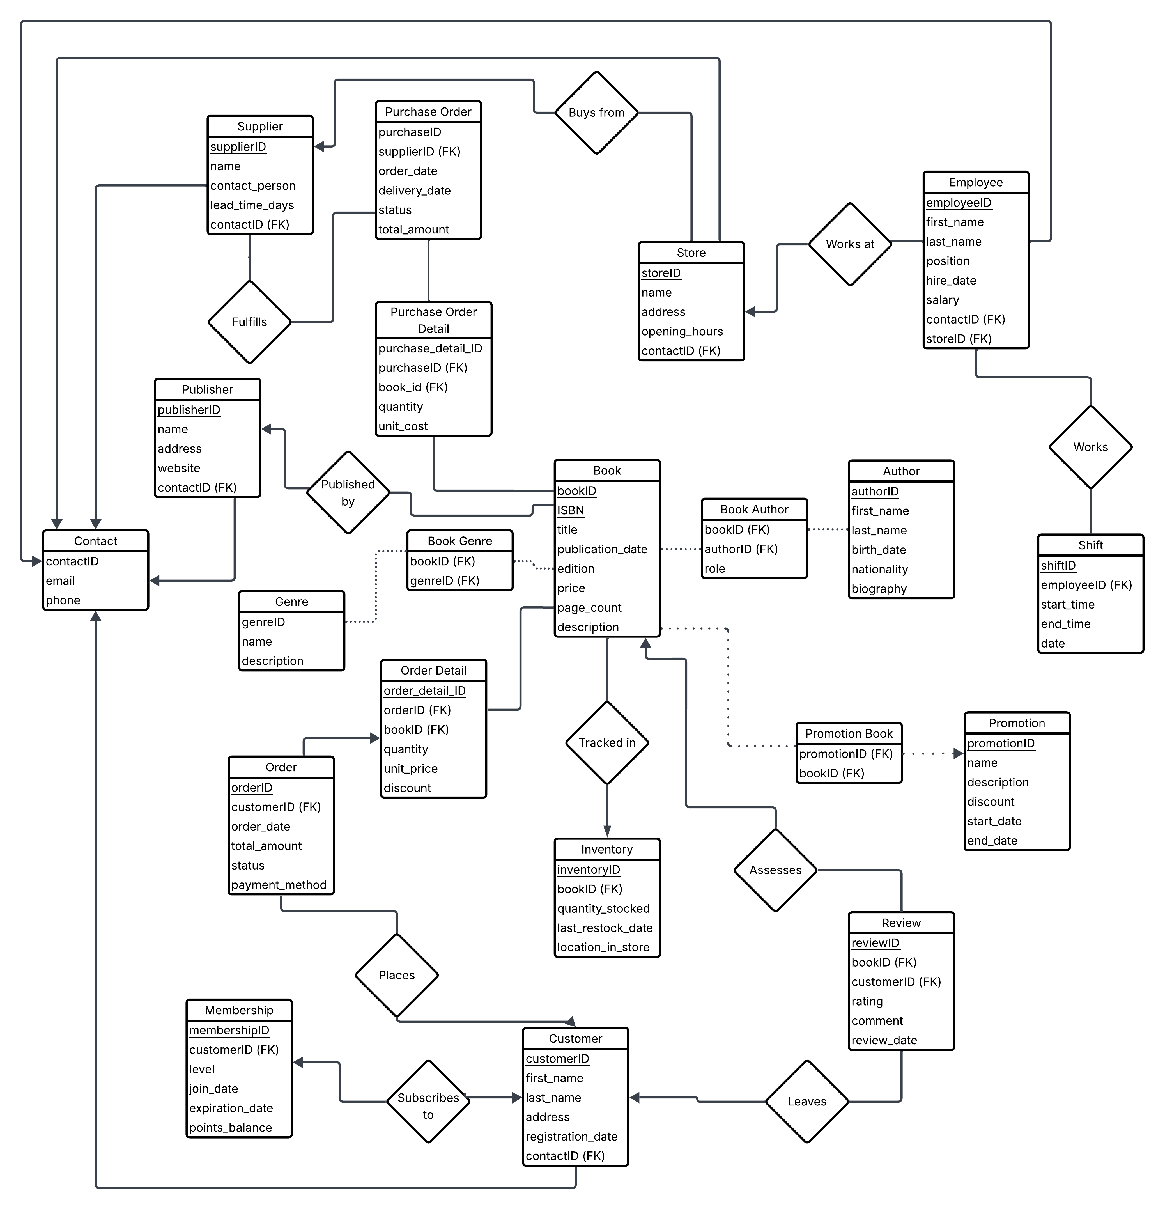
ER Diagram

Slide 4
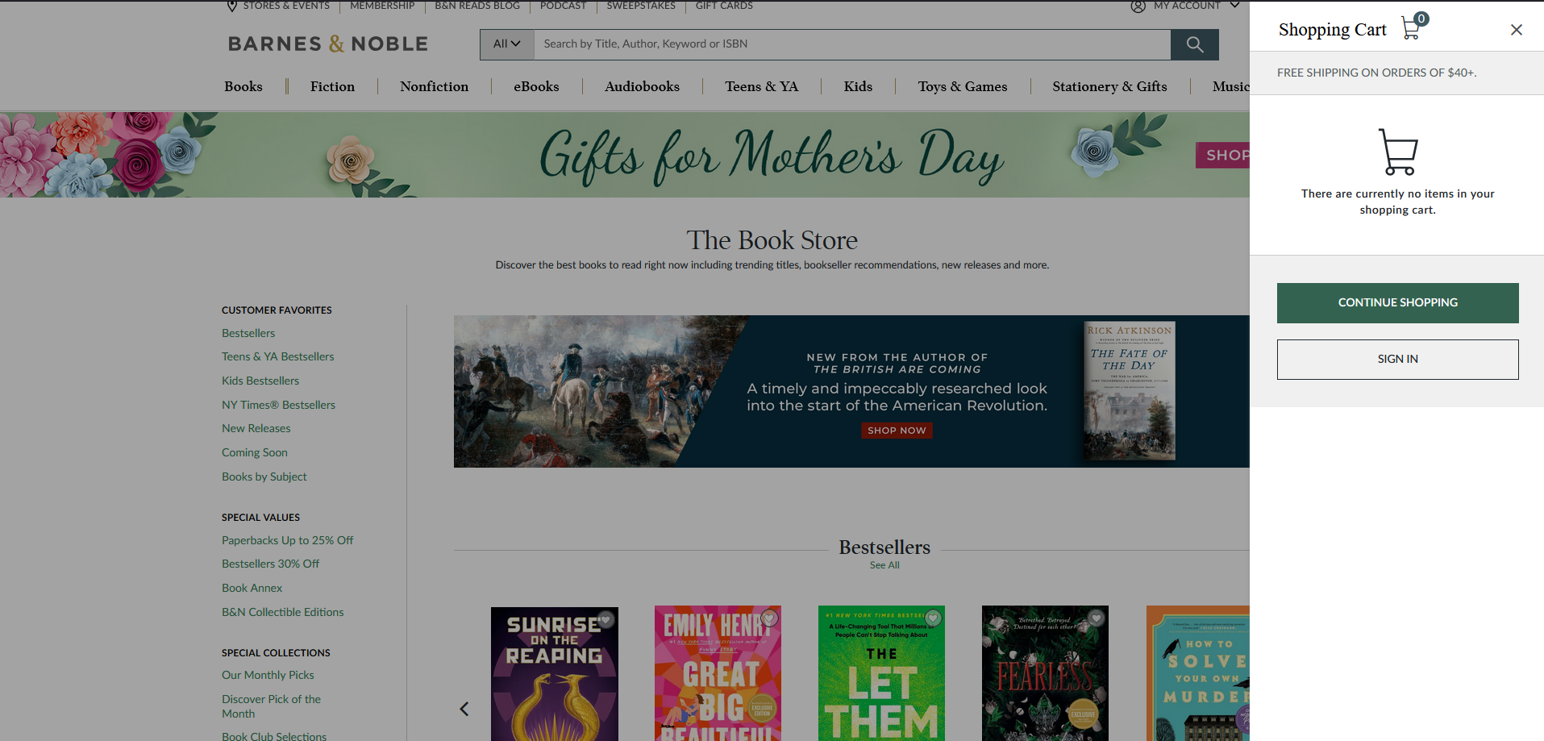

Real World Inspiration

Slide 5
Section Categories
The bookstore is broken into 4 sections:
Retail (Customer)
Inventory
Employee
Management
Customers can purchase books through their cart
Inventory keeps track of books and allows updating or removing the books, as well as adding new books
Employees can check in or out of their shift and sign customers up for memberships
Management takes care of the suppliers, Store information, and employee information

Slide 6
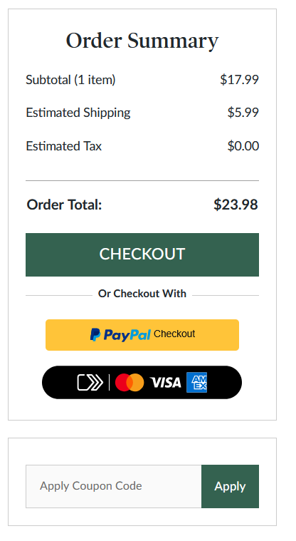
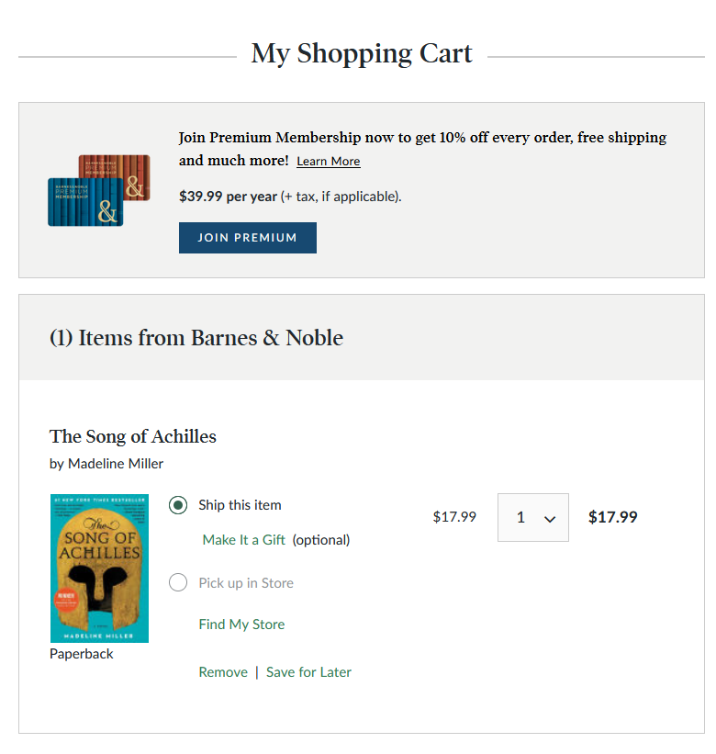
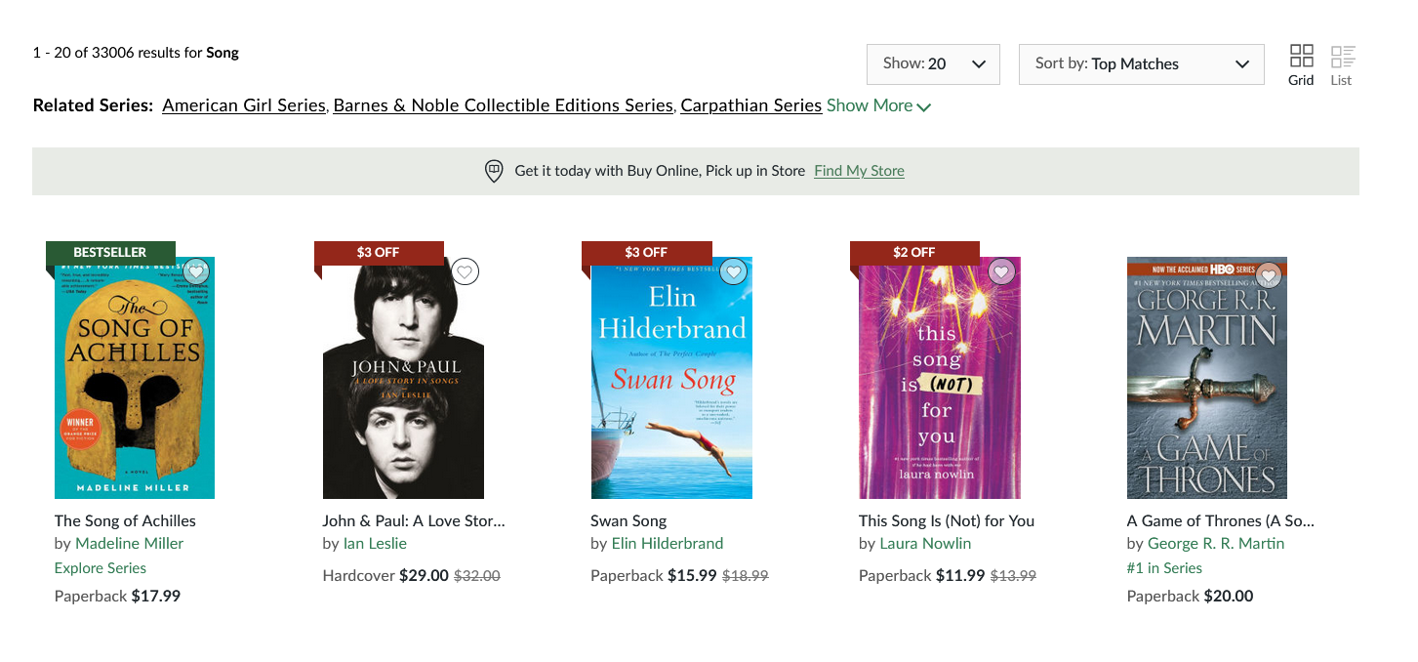
Customer Page

Slide 7
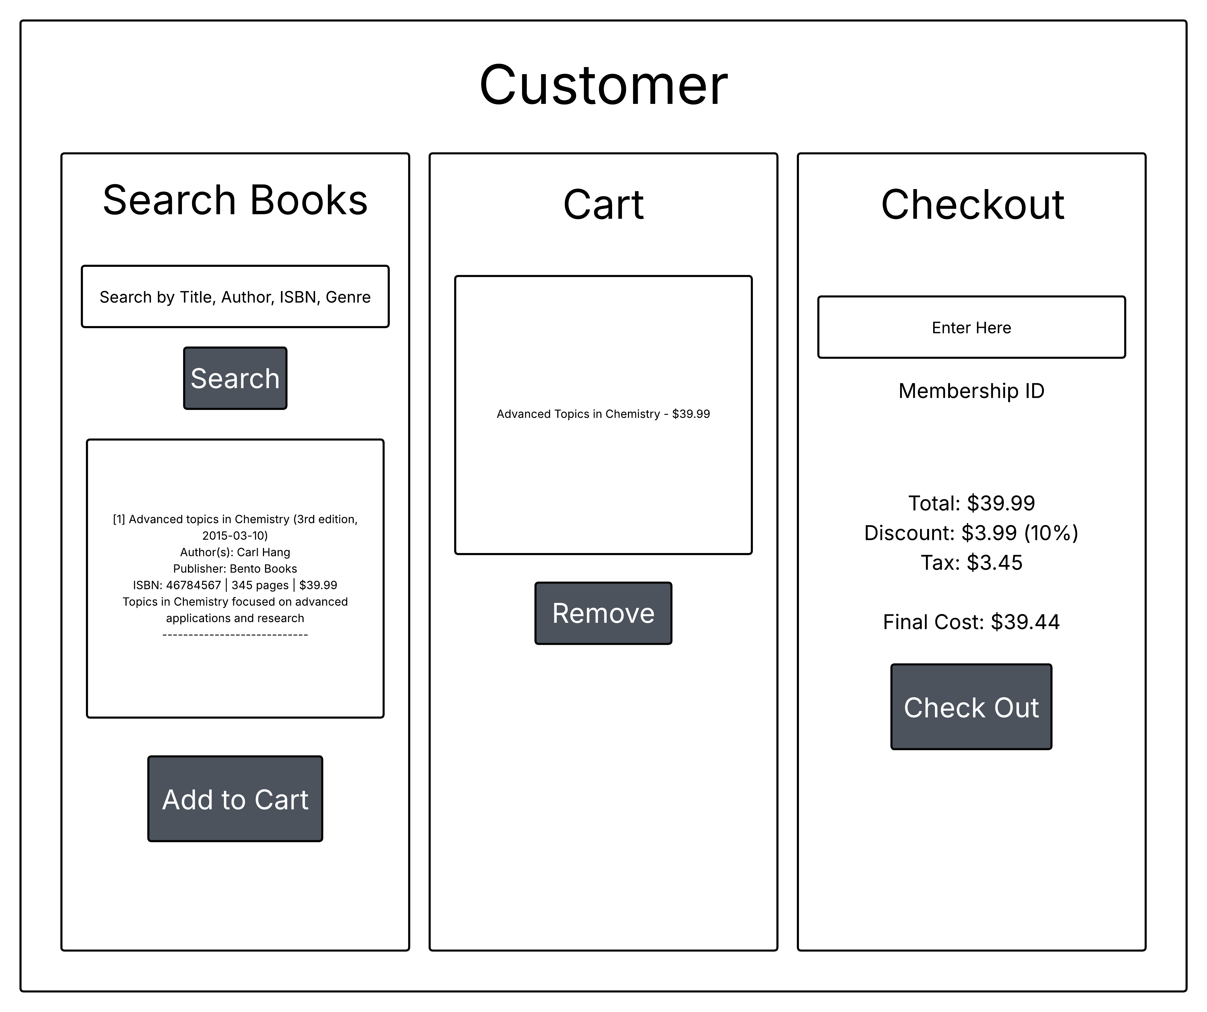
Design Implementation Customer

Slide 8
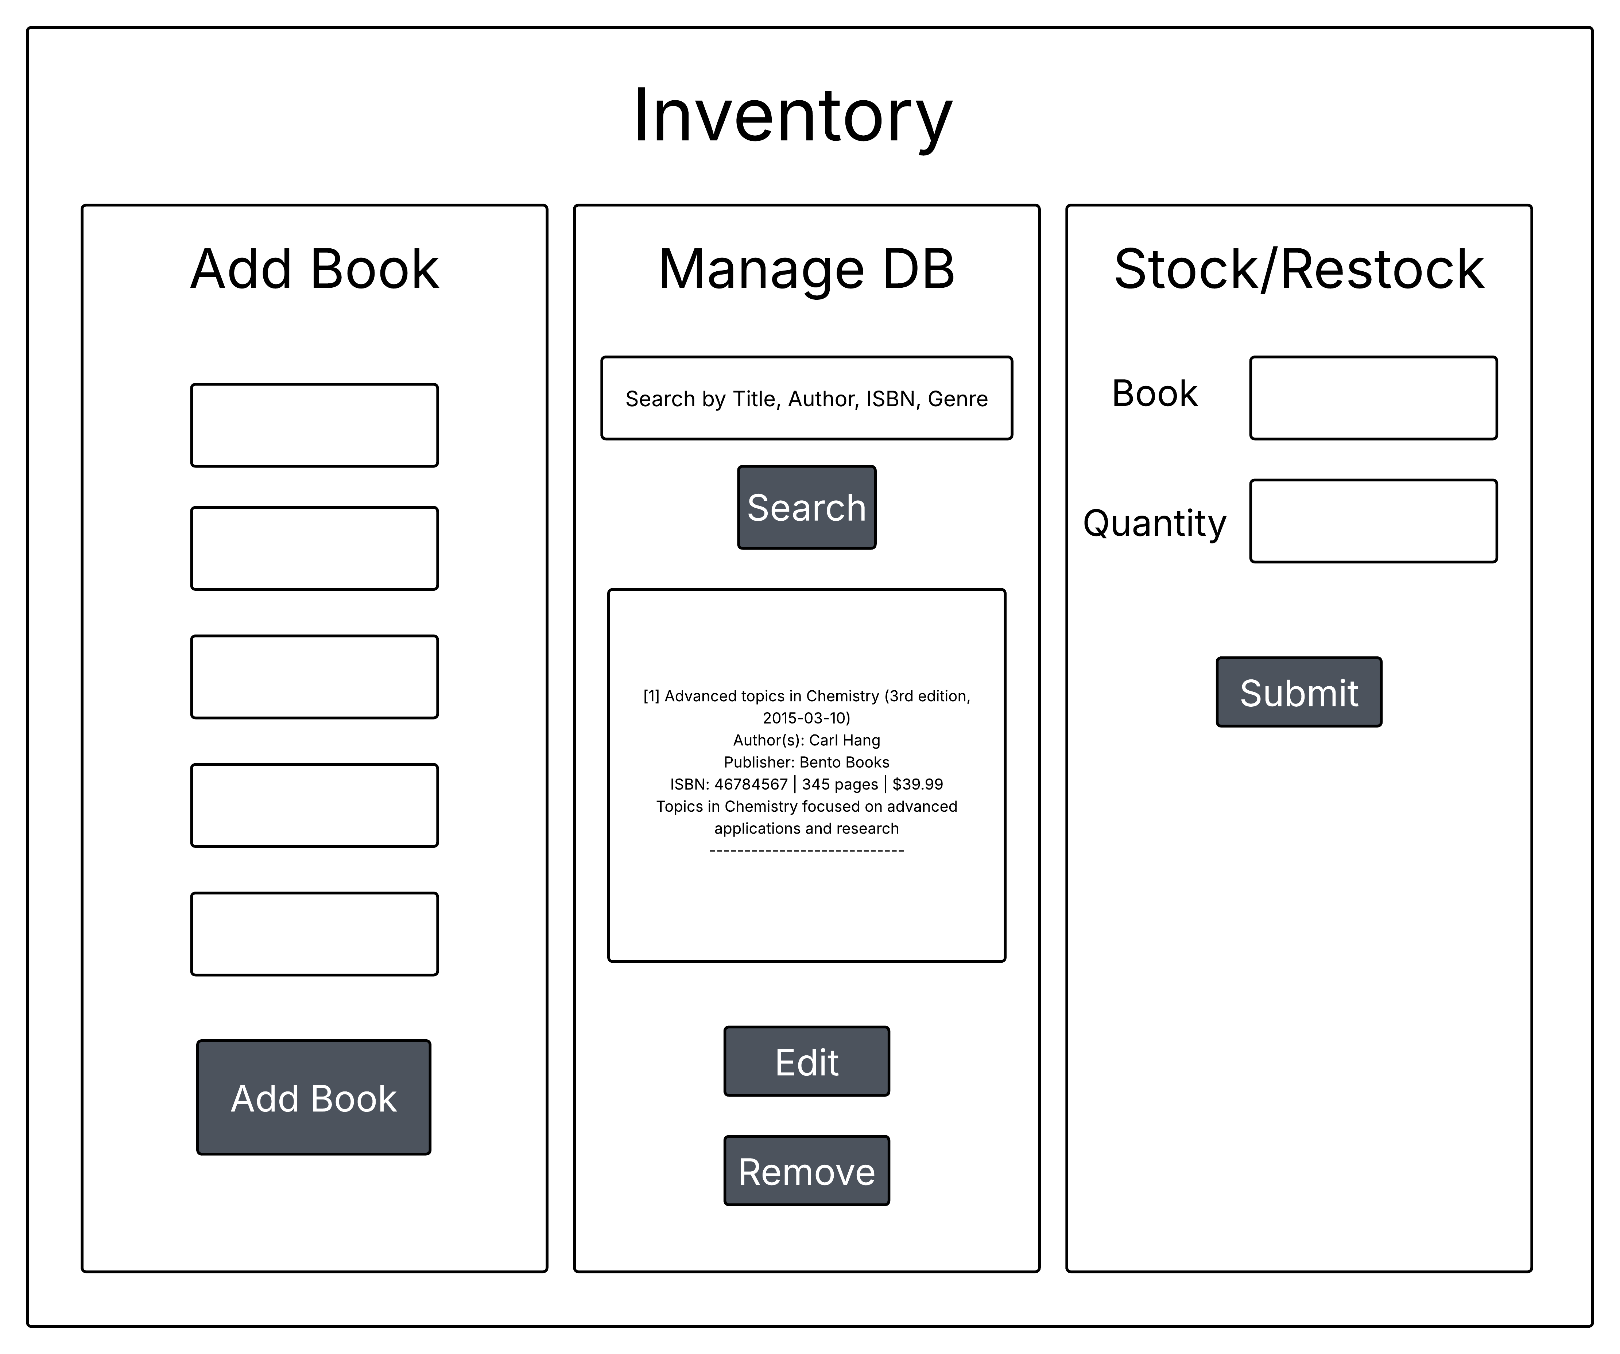
Design Implementation Inventory
Discussed with a friend who works at Barnes and Noble:
Inventory search uses keywords to show books, their authors, the location in the store, and the amount in stock

Slide 9
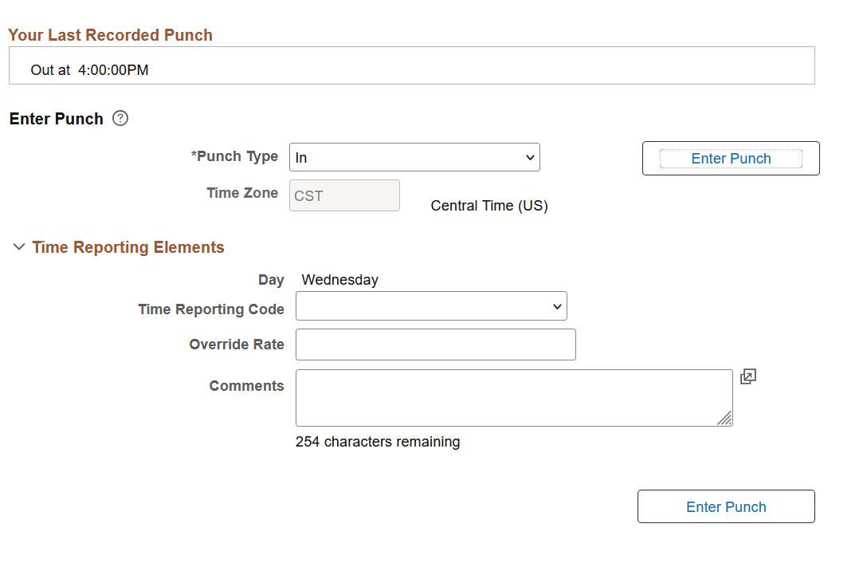
Employees Page
Modeled after typical punch in page found in company employee side

Slide 10
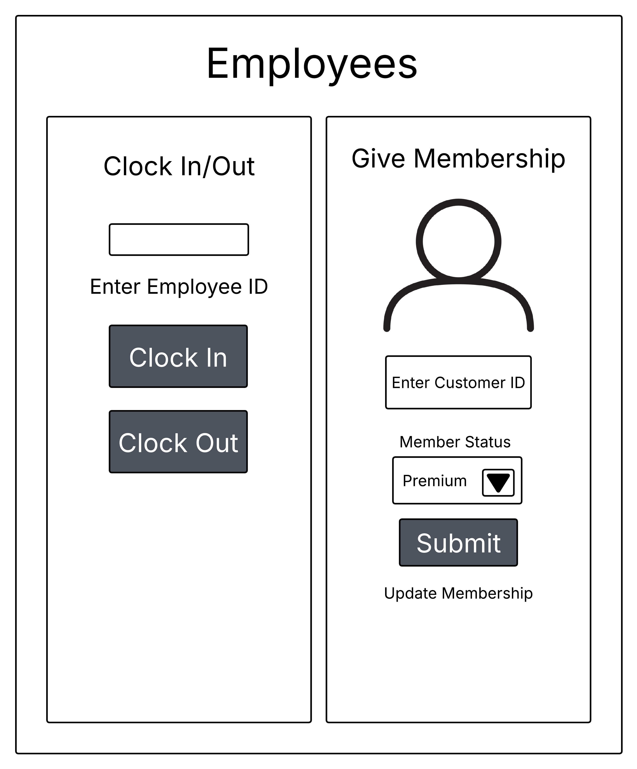
Design implementation Employees
Included the ability to give membership to customers (like at a checkout counter)

Slide 11
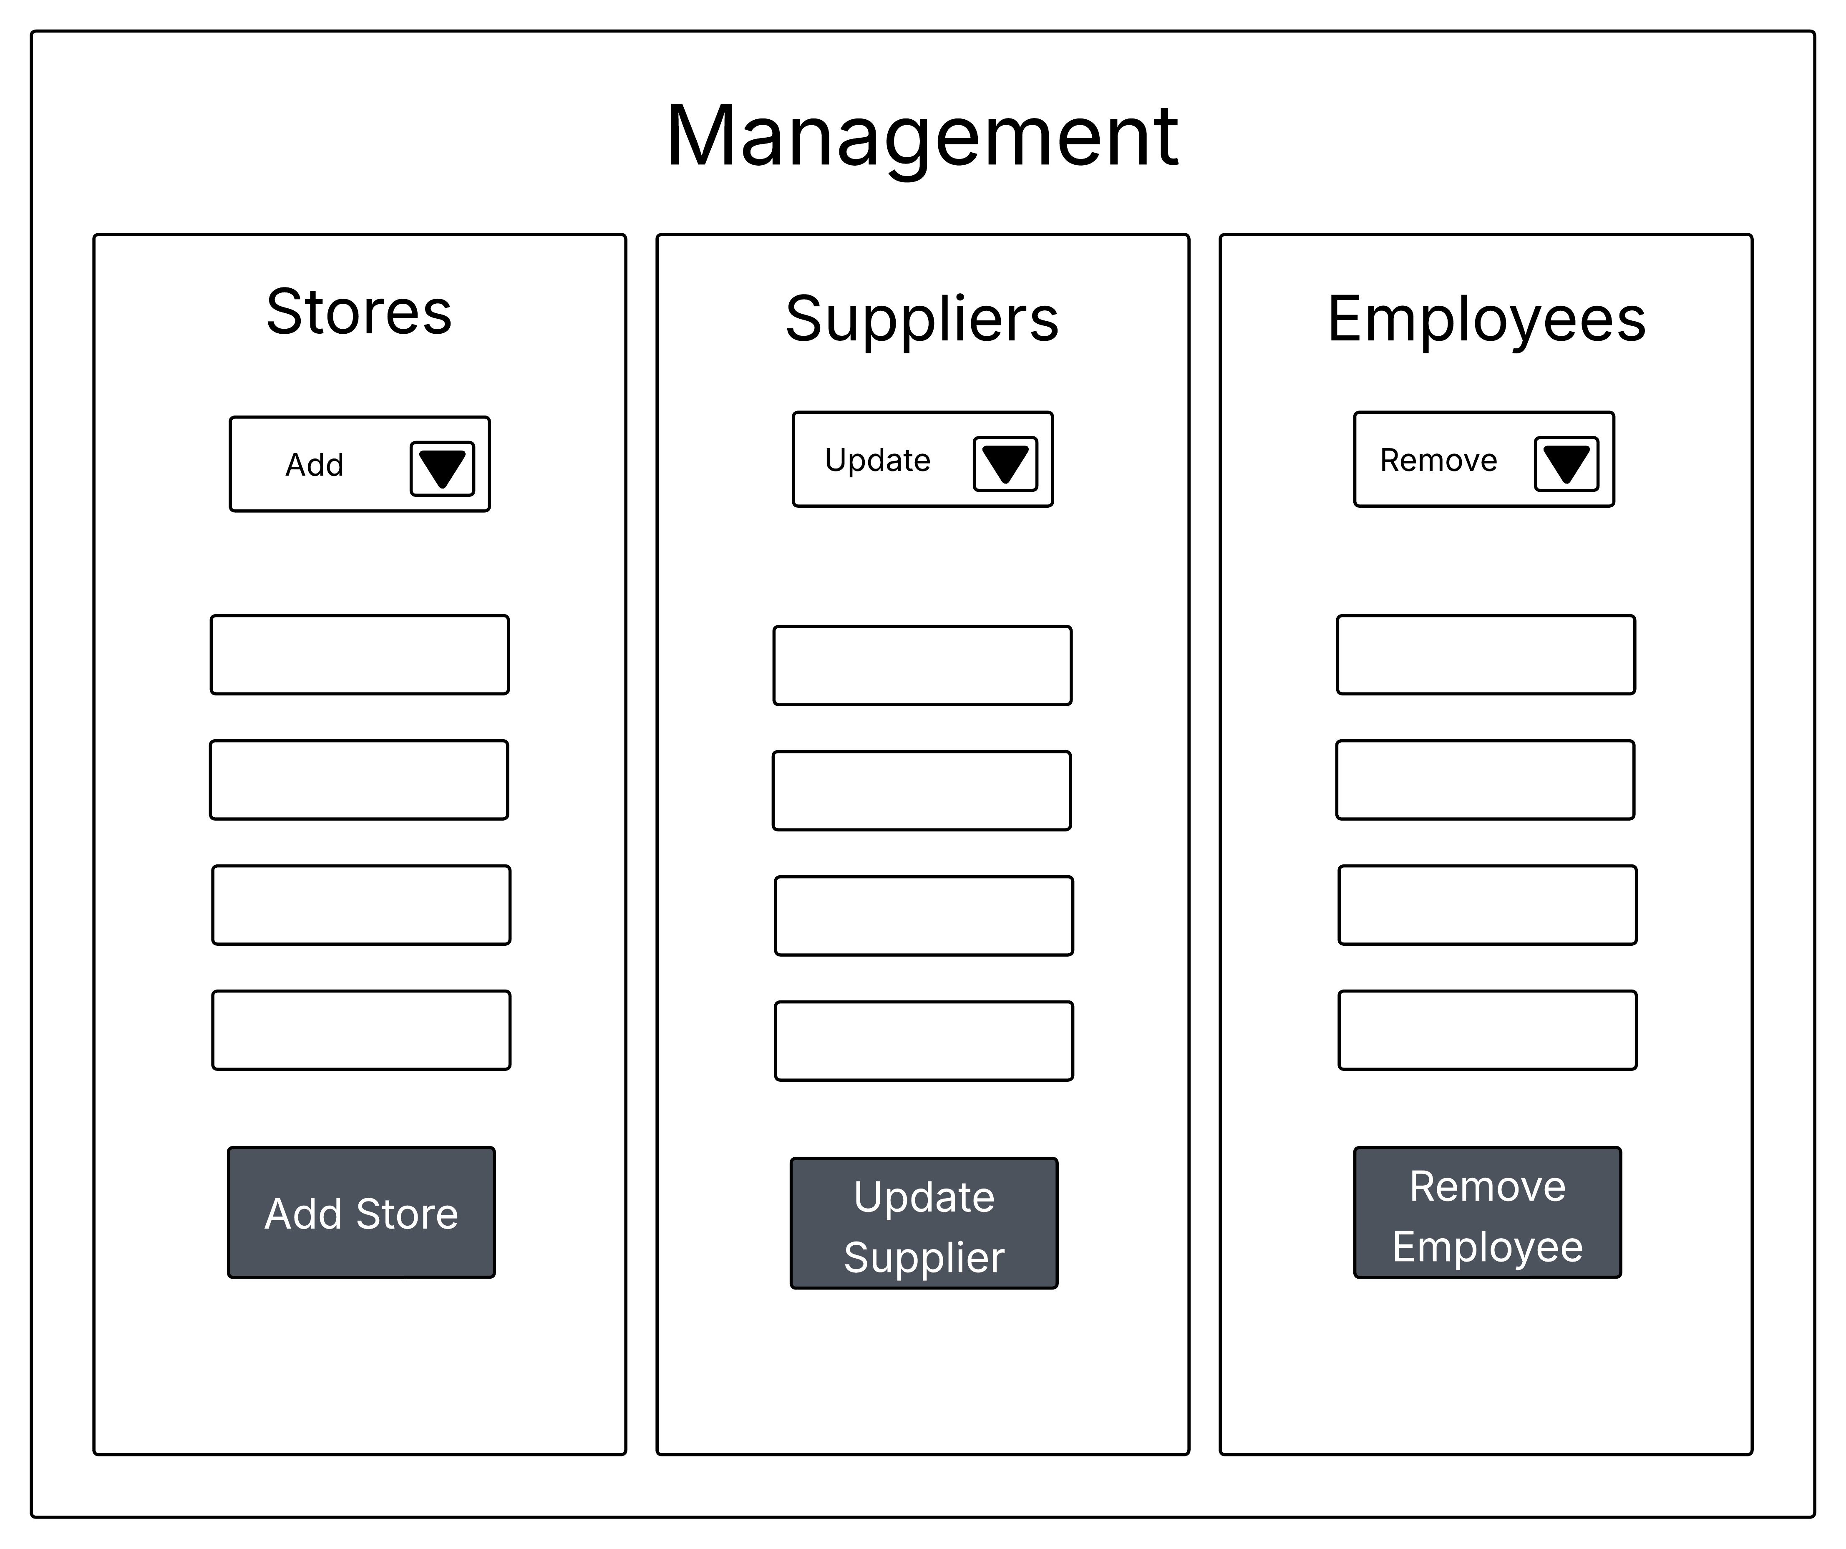
Design Implementation Management
Relationships managed my manager, would extend beyond inventory management.
Focuses on aspects managers would have control of, such as store information, suppliers, and employees

Slide 12




System Details
DBMS: MySql
Programming Language: Python
GUI: Tkinter
Version Control/Remote Repository: GitHub

Slide 13
Demo

Slide 14
Thank You

